Slide 1
COURSE NAME – Cloud and devops COURSE CODE:22CS2243F Cohort-E27 (SEDP) Software engineering mis and Devops prepared by nirosha bandla
Topic:
DOCKER WITH PIPELINE

Slide 2
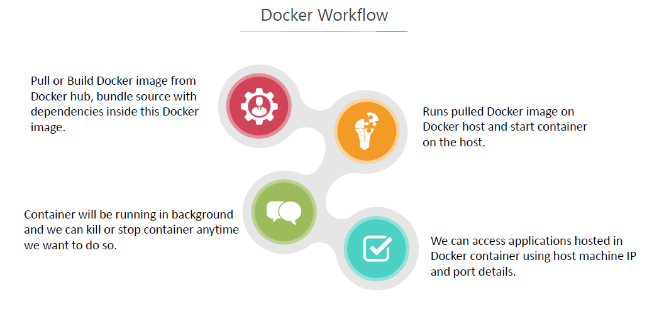
Docker Workflow

Slide 3
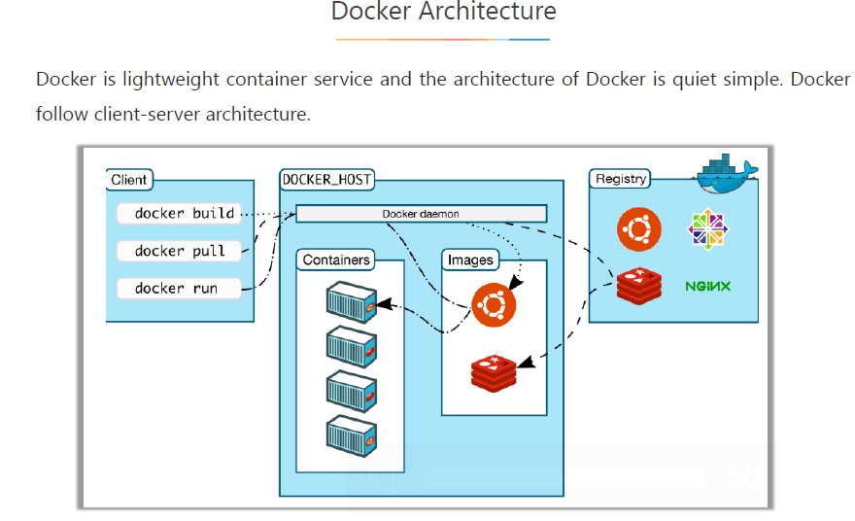
DOCKER ARCHITECTURE

Slide 4
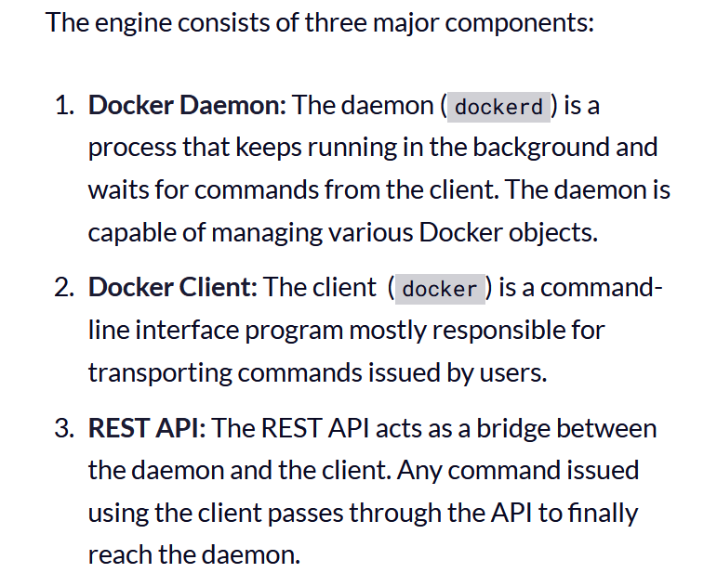
Docker Architecture

Slide 5
Docker has two main components, with a client-server architecture:
The Docker host: The Docker host contains the Docker daemon, containers, and images.
The Docker engine is an important component that provides the core Docker technology.
This core Docker technology enables images and containers.
When we install Docker successfully, we run a simple command. In our case, we will consider CentOS for the container.
To run an interactive shell in the CentOS image,
use docker run -i -t <image> /bin/bash:
The-i flag initiates an interactive container
The -t flag creates a pseudo-terminal that attaches stdin and stdout

Slide 6
The <image> is a CentOS image
/bin/bash starts a shell
When we run this command, it verifies whether the CentOS image is available locally. If it is not available, it will download the image from Docker Hub.
An image has a file system and parameter that can be used at runtime, while a container is an instance of an image with a state.
It is simple to understand that containers change while images do not.
Docker Hub: Docker Hub is a Software as a Service (SaaS) for sharing and managing Docker containers.
It is a kind of centralized registry service provided by Docker.
As a user, we can use it to build and ship applications. It allows us to create a pipeline to integrate with code repositories and for collaboration, image discovery, and automation.

Slide 7
Docker Architecture

Slide 8
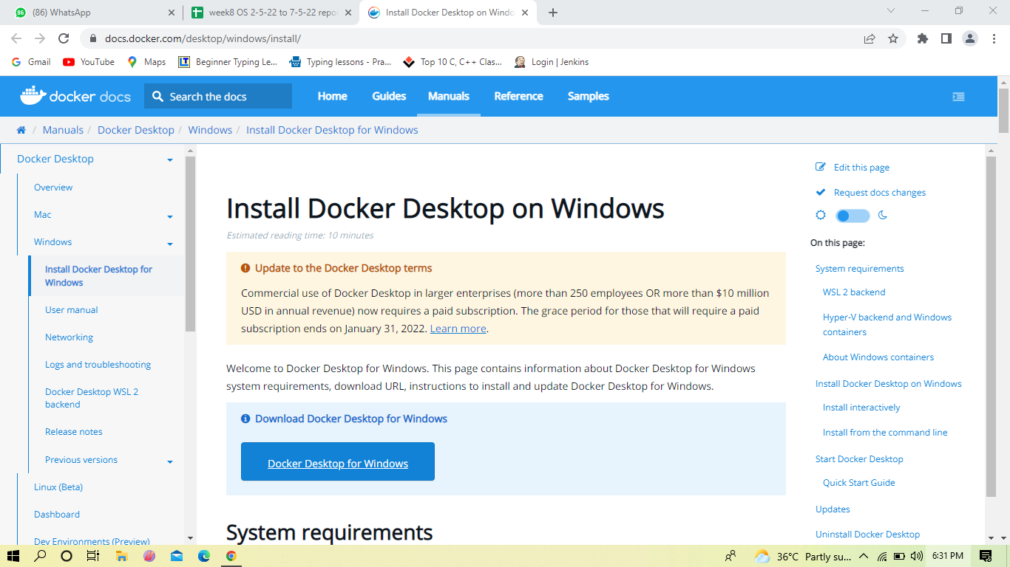
Installing Docker in windows
Notes:
A container is a way to package applications with everything they need including the dependencies and all the configurations.
Microservices are tiny piece of functionalities that are used as a service. These are independent building blocks, with the help of which it becomes easier to create, test and understand an application

Slide 9
DOCKER INSTALLATION &
CRATING ACCOUNT IN DOCKER HUB
Notes:
Good Day All,
I am Anjana.
In this lecture,I am going to give an Overview on Docker from Continuous Delivery and Devops.

Slide 10
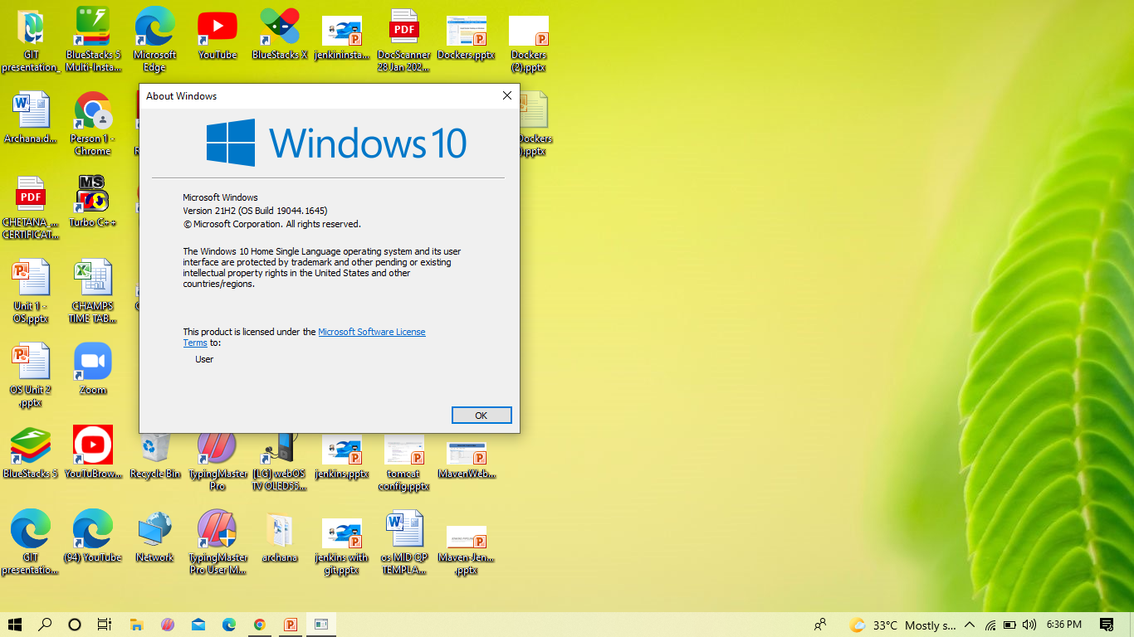
Notes:
In General, to deliver any product to the Customer, supplier has to take into consideration these things, what type of transport medium and vehicle is need, what type package is needed depending on the material and expert labor is needed to carry goods from one place to another place

Slide 11
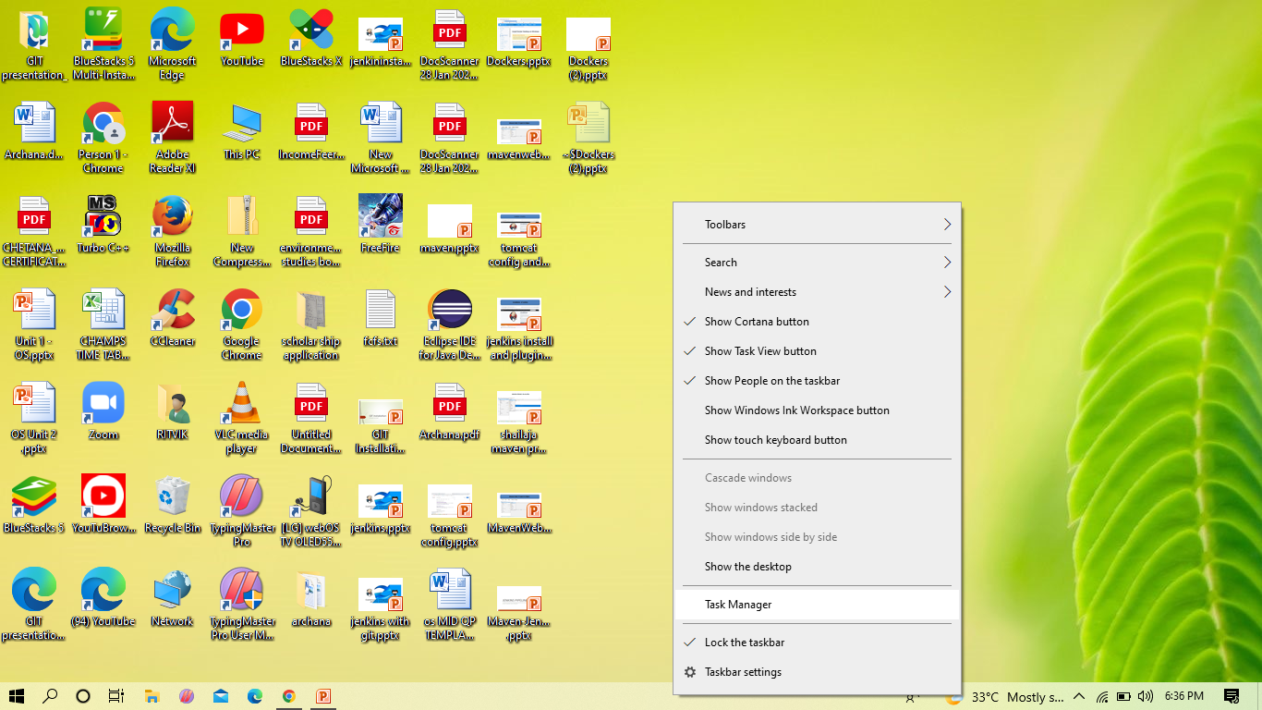
We have to check for Virtualization is enable or not
Click -> taskbar ,Select -> task manger

Slide 12
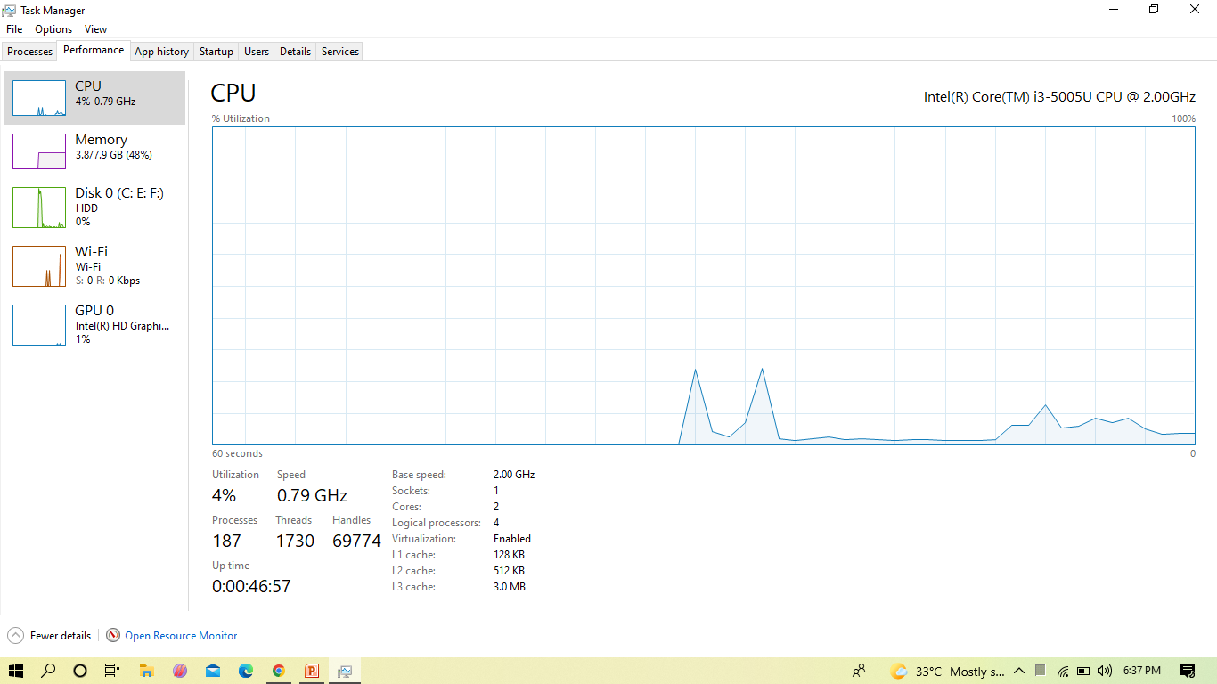
Here can see for virtualization

Slide 13
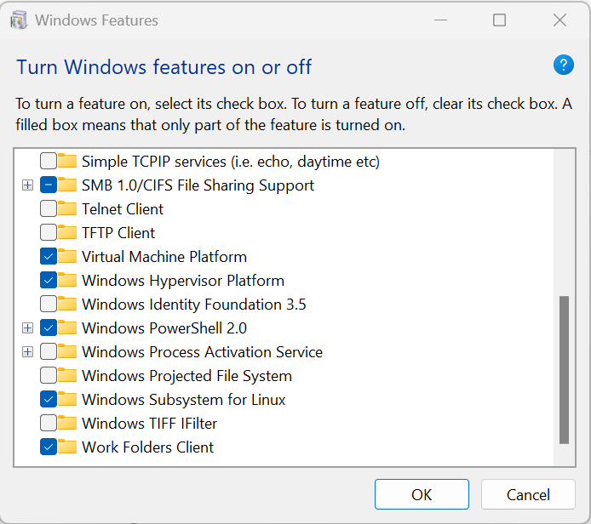
If not enabled

Slide 14
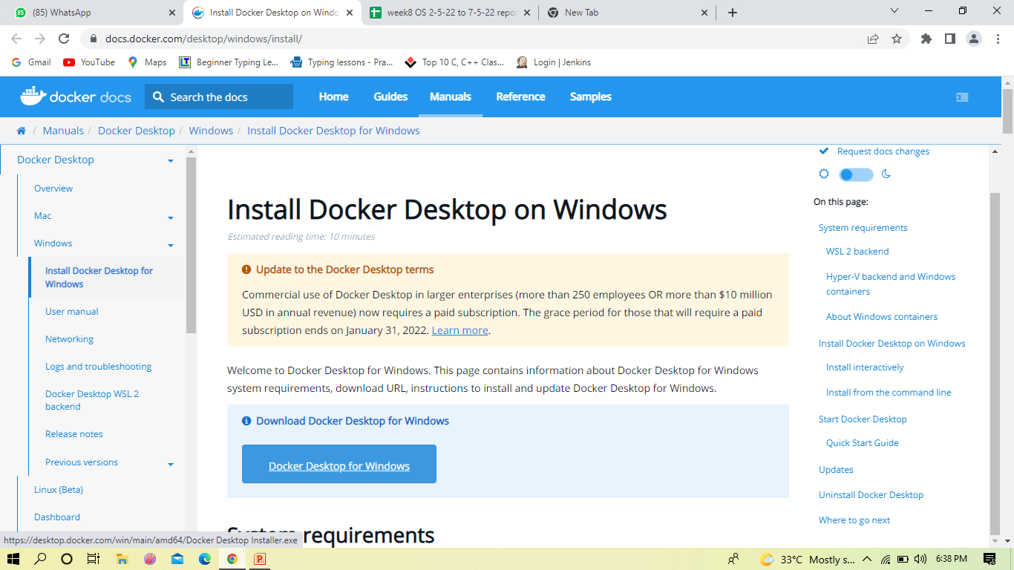
Downloading
Notes:
Before the world of Docker
Lets look at the scenario,
A Developer and the Tester.
Developer would actually build the code i.e running on their system and then they send it to the tester , but the would not work on their system.
Can any one guess what is the reason.
Yes, the code doesn’t work on the other system due to the difference in computer environments.
So what would be the solution to this?
You could go ahead and create a virtual machine to be the same of the solution in both areas
Even a better solution is Docker

Slide 15
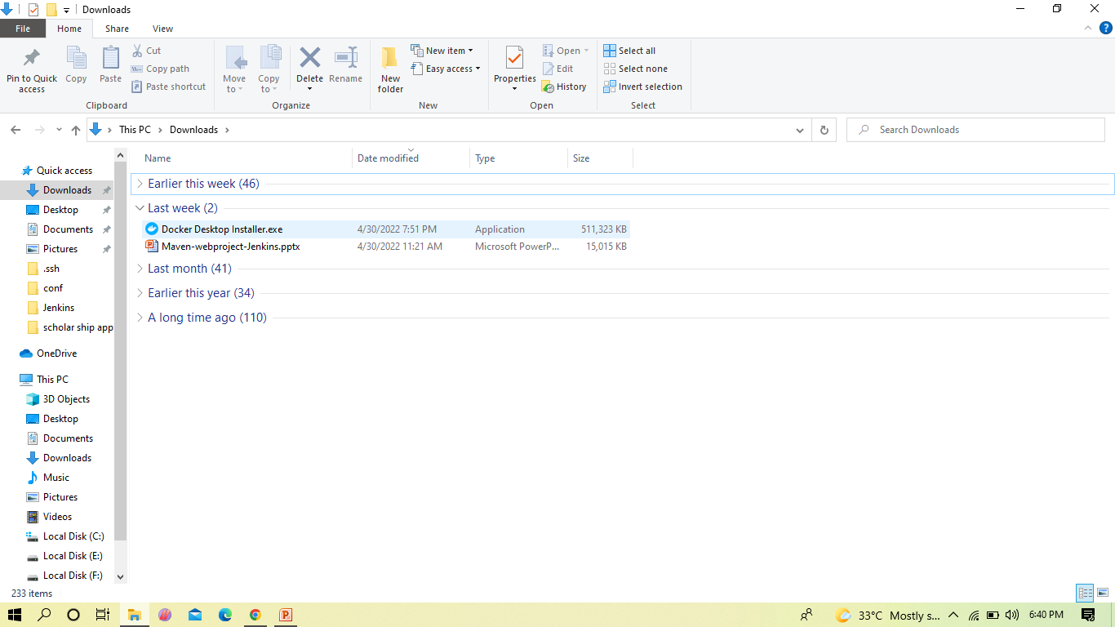

Slide 16
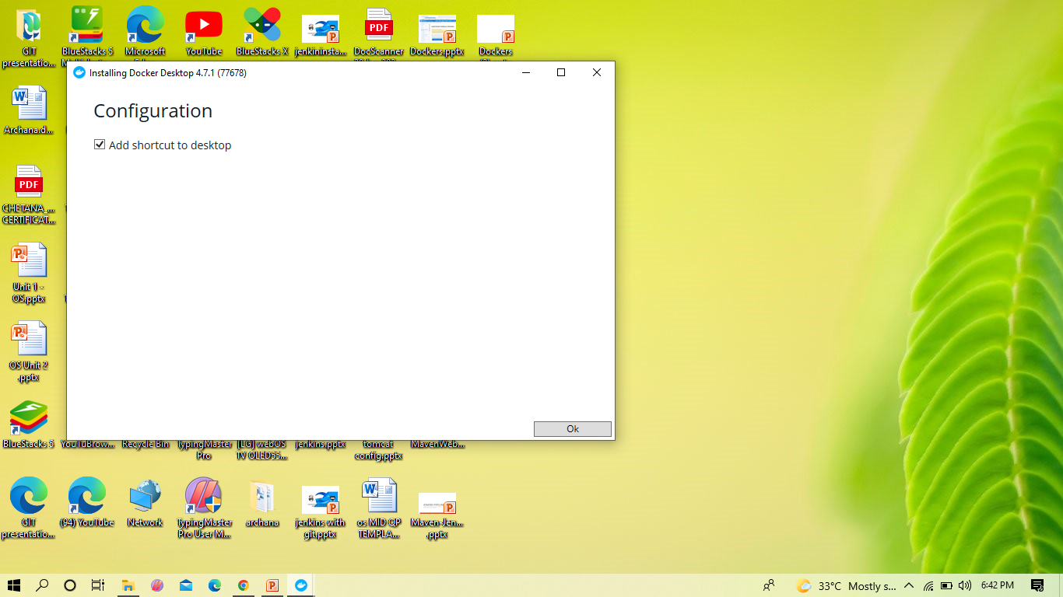

Slide 17
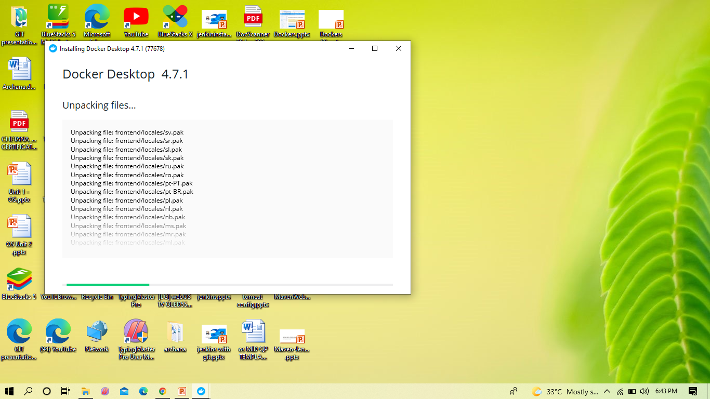

Slide 18
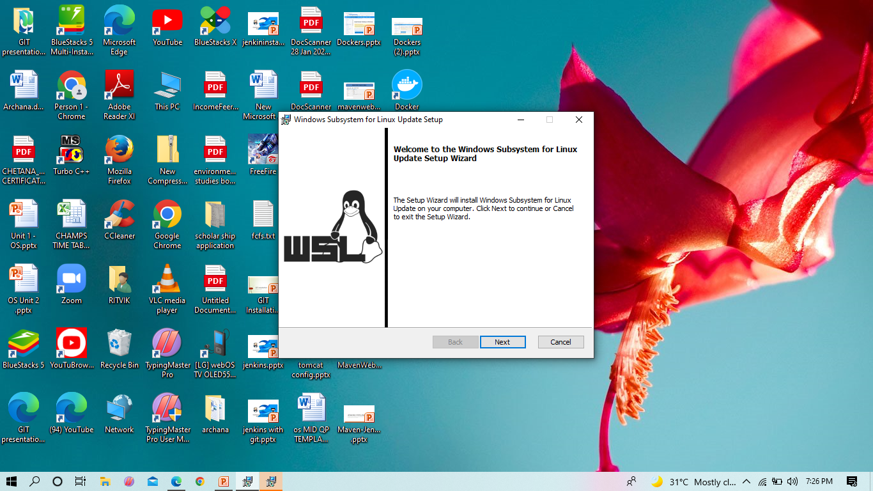

Slide 19
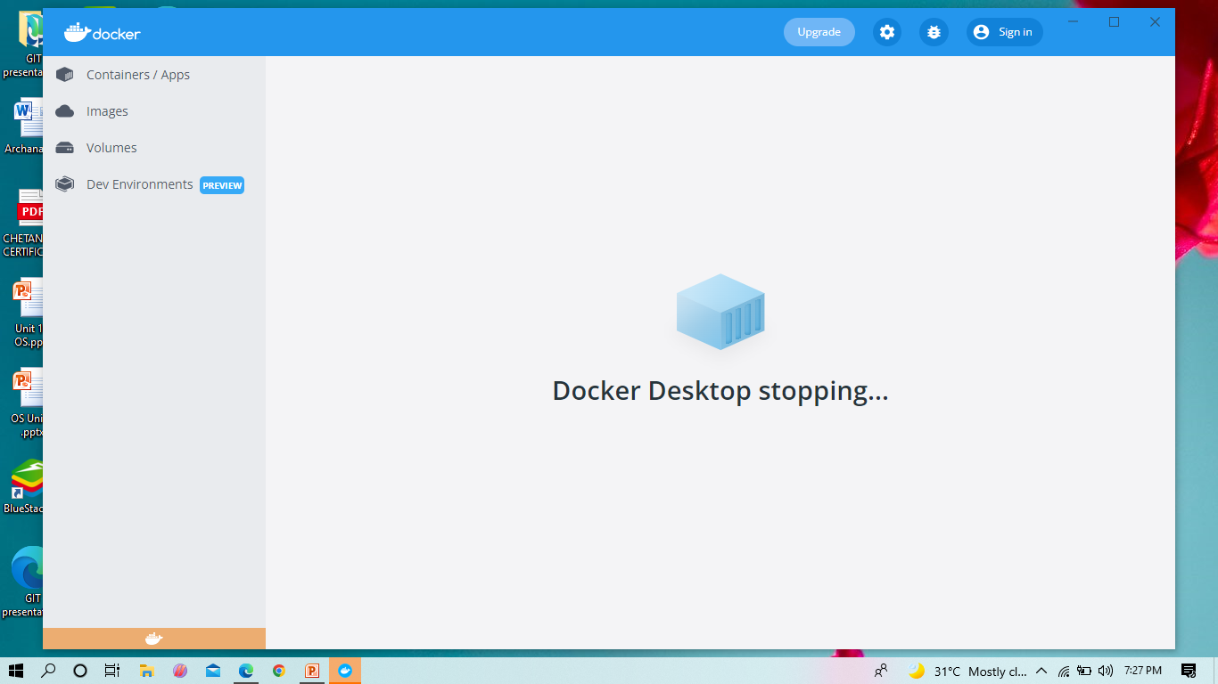
Sign in Docker Hub

Slide 20
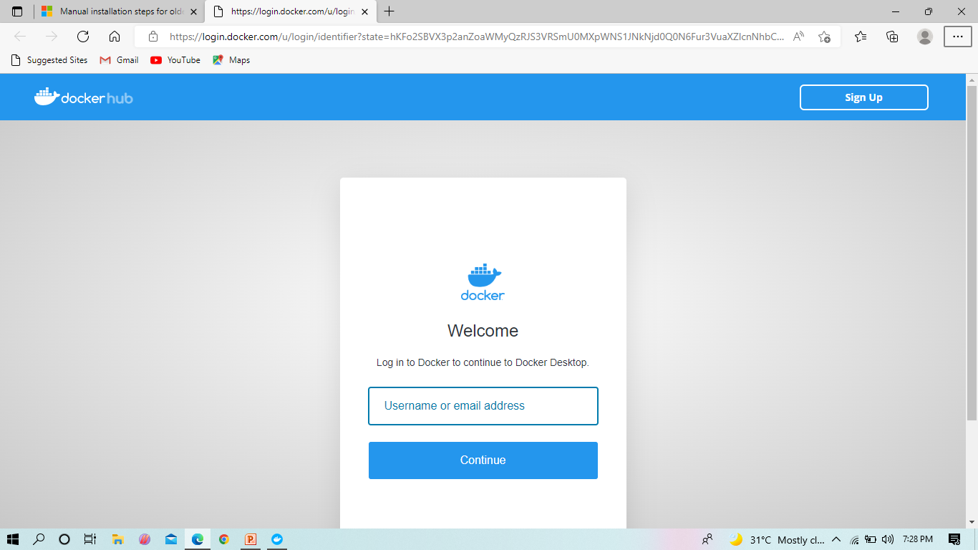

Slide 21
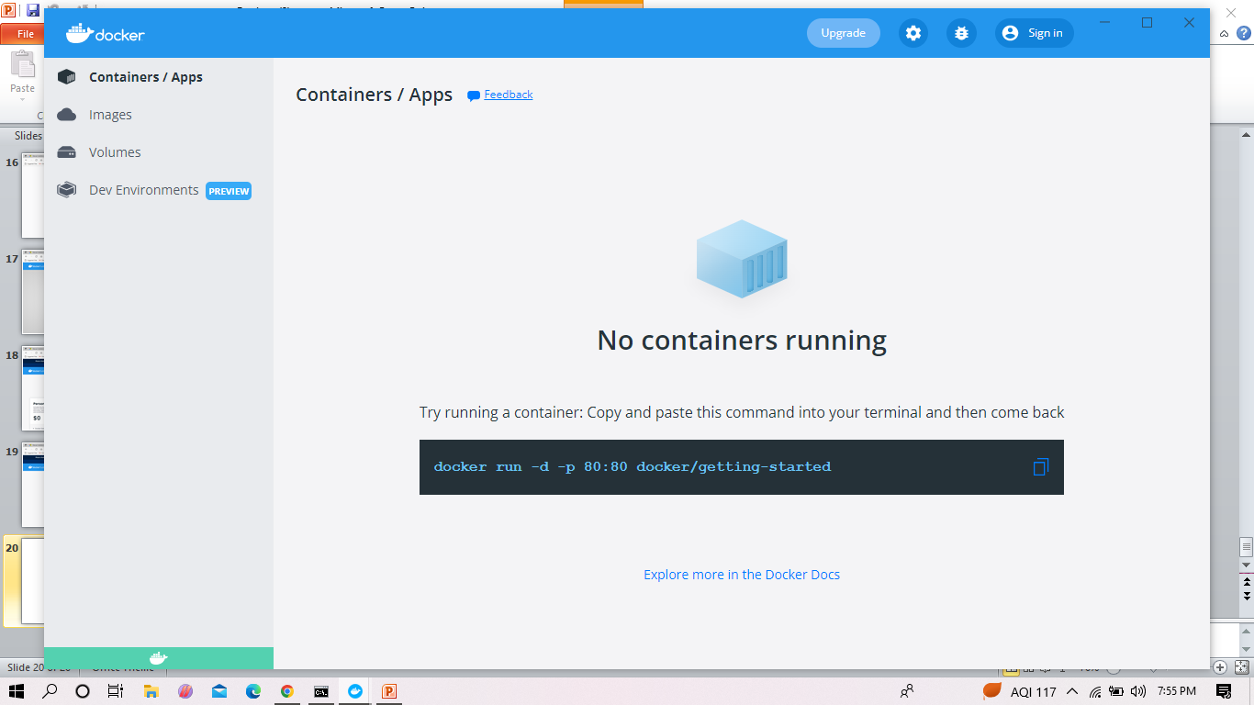

Slide 22
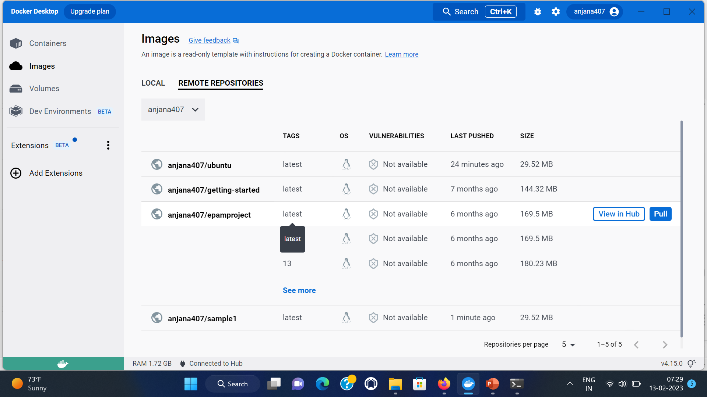

Slide 23
What is Docker Hub?
Docker Hub is the official online repository where you could find all the Docker Images that are available for us to use.
Docker Hub also allows us to store and distribute our custom images as well if we wish to do so. We could also make them either public or private, based on our requirements.

Slide 24
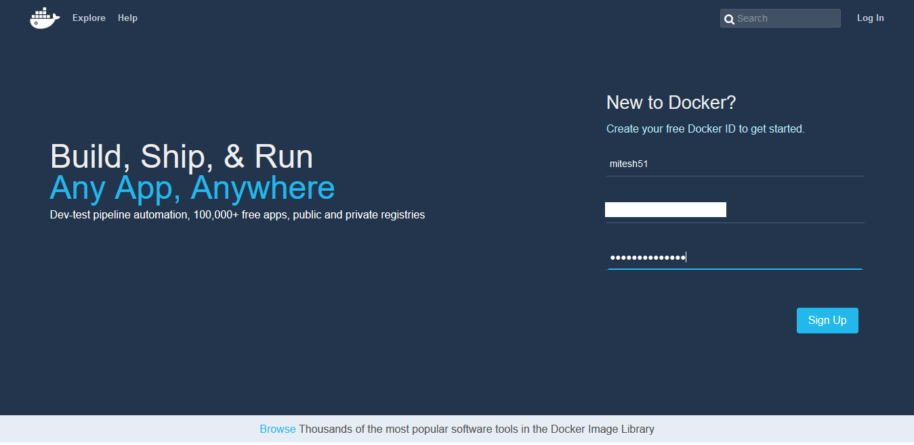
Docker Registry/Docker Hub
let's navigate to https://hub.docker.com and sign up by providing a username, e-mail, and password.

Slide 25
2. Activate your account by clicking on the activation link sent to your e-mail ID:

Slide 26
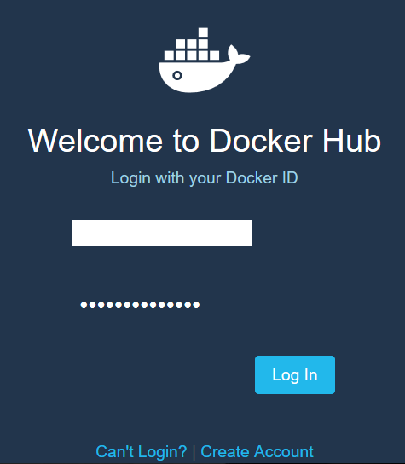
3. After successful activation, login to your Docker Hub account

Slide 27
Docker Registry/Docker Hub

Slide 28
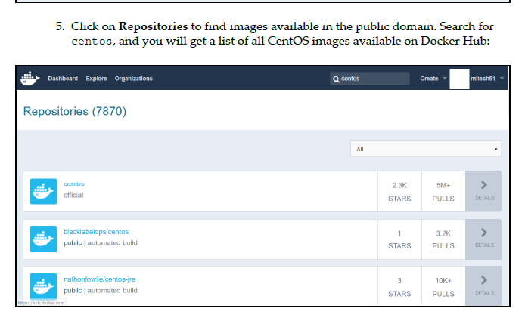
Docker Registry/Docker Hub

Slide 29
DOCKER IMAGE
An image is a read-only template with instructions for creating a Docker container. Often, an image is based on another image, with some additional customization.
For example, you may build an image which is based on the ubuntu image, but installs the Apache web server and your application, as well as the configuration details needed to make your application run.

Slide 30
DOCKER IMAGE
You might create your own images or you might only use those created by others and published in a registry.
To build your own image, you create a Dockerfile with a simple syntax for defining the steps needed to create the image and run it.
Each instruction in a Dockerfile creates a layer in the image.
When you change the Dockerfile and rebuild the image, only those layers which have changed are rebuilt.
This is part of what makes images so lightweight, small, and fast, when compared to other virtualization technologies.

Slide 31
Docker Editions
Docker is available in 2 different editions, as listed below:
Community Edition (CE)
The Community Edition is suitable for individual developers and small teams.
It offers limited functionality, in comparison to the Enterprise Edition.
Enterprise Edition (EE)
The Enterprise Edition, on the other hand, is suitable for large teams and for using Docker in production environments.

Slide 32
Enterprise Editions
The Enterprise Edition is further categorized into three different editions, as listed below:
Basic Edition
Standard Edition
Advanced Edition

Slide 33
